Slide 1
Machine Learning to Predict Accident Severity
Johannes Danusantoso

Slide 2
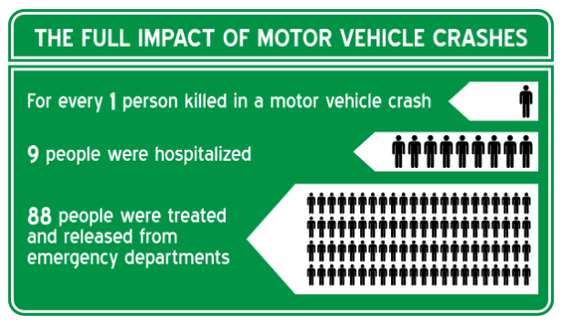
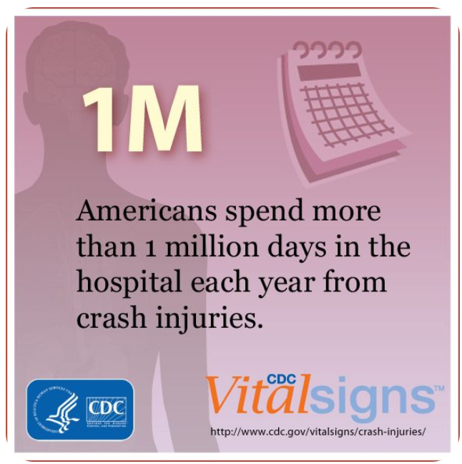
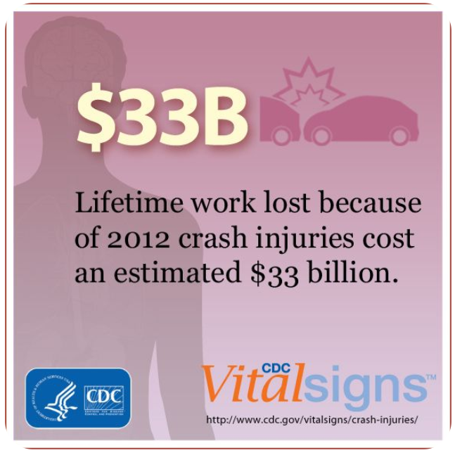
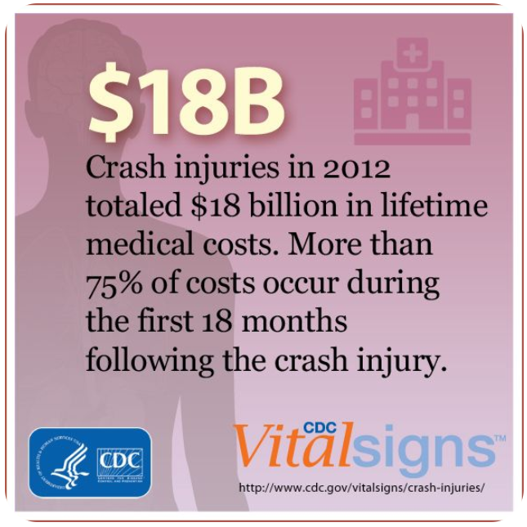
Background
Traffic accidents are a major cause of death in the US
Traffic accidents (injury and non-injury) lead to huge total economic cost and
decreased quality of life
the immeasurable burden on the victims’ families and friends.

Slide 3
Objective
Predict the severity of traffic accidents using Machine Learning with Python
Public traffic and safety officials
General population
TARGET AUDIENCE

Slide 4
Data Source
We use the collision dataset published by the City of Seattle.
It is a public data and has more than 200k data points from 2004 to present with 40 attributes.
Group the target to 2 classes:
Property damage only (no injuries)
Injuries (including fatalities)
Imbalanced datasets: ~70% of the data belong to class 1
DATA UNDERSTANDING

Slide 5
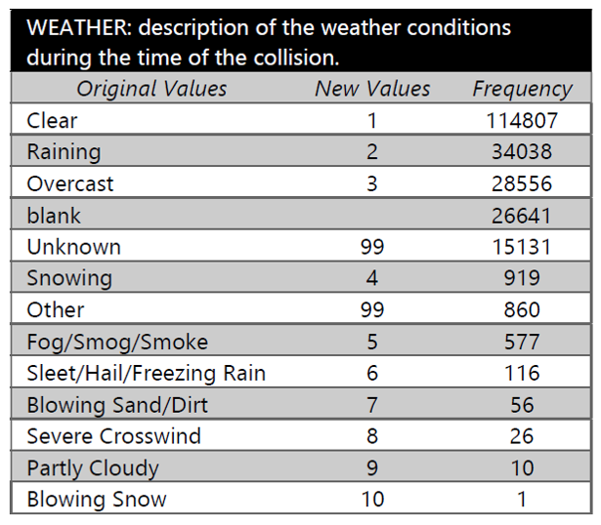
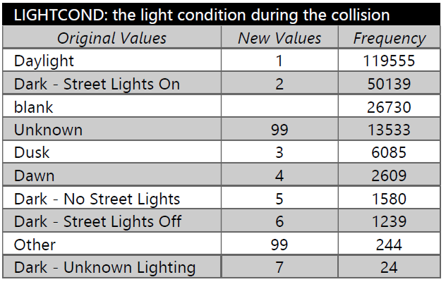
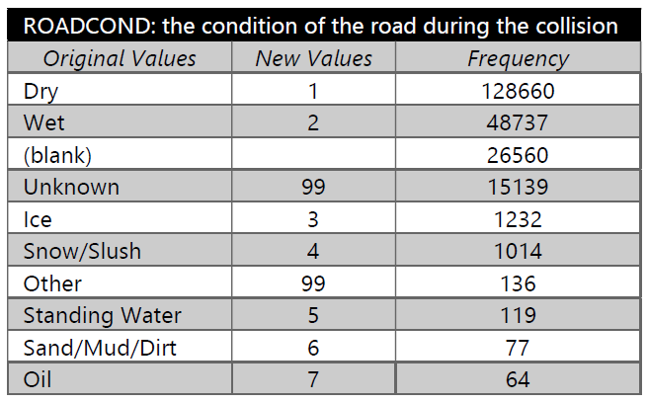
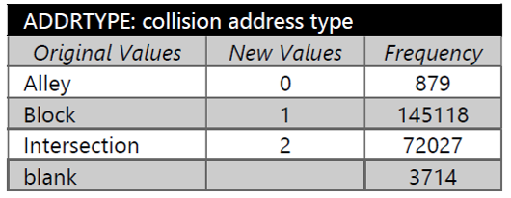
Data Preparation
Transform the categorical values to numerical values.
Perform attribute selection using Univariate Feature Selection and determine the top attributes contributing to model accuracy:

Slide 6
Modeling
Handle imbalance datasets
Balanced Bagging Classifier
Undersampling
Train/test dataset: 80% / 20%
Machine Learning algorithm
Support Vector Machine (SVM)
K-Nearest Neighbor
Decision Tree
Logistic Regression

Slide 7
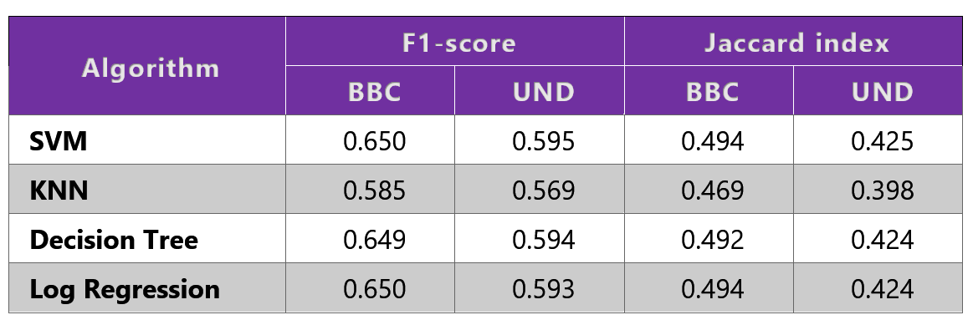
Results
1 = perfect accuracy for both
F1-score and Jaccard index
Balanced Bagging Classifier (BBC) outperforms Undersampling (UND)
SVM, Decision Tree, and Log Regression performs equally well

Slide 8
Conclusion
We achieve ~65% accuracy in predicting the accident severity using SVM/Decision Tree/Log Regression with Balanced Bagging Classifier with the weather/road/lighting condition and the location of the accident as the input.
Further study should be conducted to improve the model accuracy using different method of handling imbalance data.

